Slide 1
Restaurant Chatbot
AIDI - 2000 – APPLIED MACHINE LEARNING
Saurav Bisht(100850875)

Slide 2
Introduction
What is a chatbot?
It is a class of bots that existed in the chat platforms and is an intelligent system developed using AI and NLP which can understand human language, process it, and interact back with humans while performing certain tasks
What is Interesting about chatbots today?
They have become so humane that we do not feel that we are talking to a machine. It has become that advanced

Slide 3
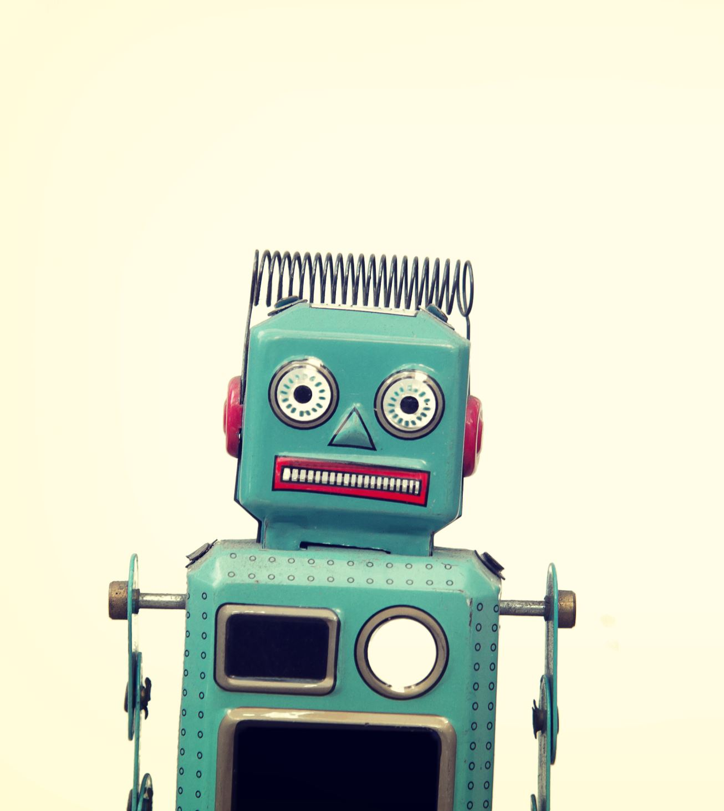
Types of Chatbots
Text-Based Chatbots
Voice-Based Chatbots
Rule-Based Chatbots(Answers questions based on rules on which it is trained. It can be simple to complex)
AI-Based Chatbots(Self-Learning Chatbots)

Slide 4
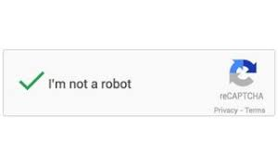
Problem Statement
Considering a scenario where client asked us to develop a chatbot for their Italian fast-food pizza joint.
Chatbot must cover most basic aspects of customer support while providing the necessary answers to the user in most humane manner possible.
We decided to developed Rule based AI chat bot for the above tasks keeping in mind the simplicity of the chatbot.

Slide 5

Stages of development
The following were the stages of deployment:
Model building
Intents Data
Word Stemming
Bag of Words
Implementing Feed Forward Network
Model Fit and Save
Flask API integration
Front-end
Deployment

Slide 6
Intents.json
Creating training data for the chat bot
A JSON file allows us to create a number of messages that a user is likely to input and maps those messages to a respective of answers.
With this data we trained a neural network to take a sentence of words and classify it as one of the tags which matches with one of the tag from the intents.json file.
These tags and responses will be in respect to the
Structure of intents:
Tag
Patterns
Responses

Slide 7

Word Stemming
Stemming means to find the root of the word. Example: “happening”, “happened” can be interpreted as “happen”.
The aim of stemming is to reduce the overall vocabulary of the model
The above code simply creates a list of stemmed words and sort it into ascending order

Slide 8
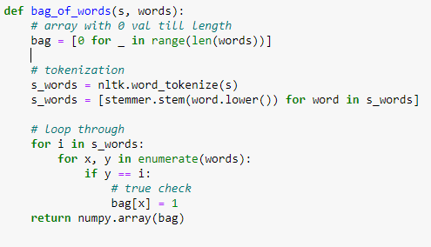
Bag of words
The essential feature of bag of words is to convert the string of stemmed words into numeric values.
This conversion is important as feed forward network requires numerical input for training.
The value of this bag of words represents whether the word is present in the sentence or not.
It has a value of Either 0 or 1

Slide 9
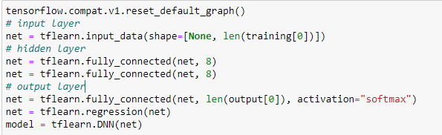
Feed Forward Network
The basic Two hidden layer feed forward network each having 8 neurons with input and output layer was used for the model training
The activation function at the output determines the score of the tag as percentage.
This essentially means that tag having max percentage of similarity according the model will be selected as the predicted tag

Slide 10
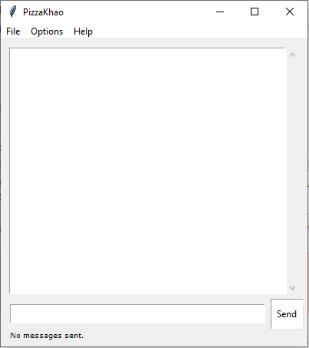
Front-End
Used Tkinter which is an inbuilt python module to create GUI Applications.
Different options are added to the UI.
Users have the following options in the UI.
File > Clear Chat and Exit.
Options > Font and Color Theme.
Help > About DBot and Developers.
Challenges faced:
Not being able to create executable file for the given interface.

Slide 11
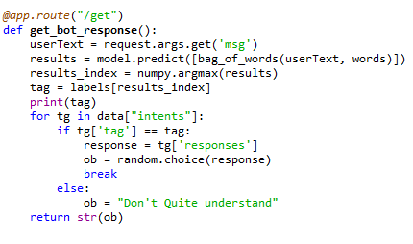
Flask API
Get method was used to get response request from the user .
The input is then fed to model to predict the tag.
Further, tag is allowed to match with respect to the response.
The response is returned as a string

Slide 12
Problems
Tkinter interface failed to comprehend the nltk library into its structure giving errors during production of executable file.
Tensorflow library was too big to get compressed during deployment stage (Heroku)
Heroku failed to download nltk corpus file during the deployment.
Since chatbot was trained for a set number of rules, thus cannot interpret complex sentences yet

Slide 13

Conclusion
Learned to develop a chatbot from scratch using hybrid methodology of Rule based and AI based approach.
How to deploy chatbot.
How to design and Train Network
Html and Tkinter interface design capabilities.

Slide 14
Thank You

